Slide 1

Agentic AI Builder: Low-Code AI Agents & Voice Agents in n8n
Week 1
Day 2

Slide 2
3 Weeks to Agentic AI Builder
Core skills
Integrations
Projects
Week 3: Amplify with multi-agent systems and MCP
Self-hosted n8n and Local LLMs
Advanced Integrations
MCP
Context Engineering, Sub-Agents
Capstone: Amplify your business
Week 2: Accelerate with Voice Agents and RAG
Voice Agents with ElevenLabs
Integrating ElevenLabs and n8n
RAG and Agentic RAG
Supabase Vectors and Data ingest
Product Expert Voice Agent
Week 1: Automate with workflows in n8n cloud
First n8n AI Agent Live
Foundations: Agentic AI and n8n
Integrations with docs and email
Data and integrations
Daily Portfolio Rebalancer

Slide 3
RECAP
What is an AI Agent?
Sam Altman
“AI systems that can do work for you independently”
Early 2025 consensus
(Anthropic, Hugging Face, ..)
AI systems where an LLM controls the workflow
Late 2025
An Agent runs Tools in a Loop to achieve a goal

Slide 4



Agentic AI
It all starts with Prompting
An LLM receives an input and predicts what comes next
It is stateless; the call to an LLM like GPT depends only on the input
The prompt can be made up of several parts
The system prompt gives overall context including role the LLM is playing
The user prompt gives the message that the LLM is responding to
The whole conversation so far can be included
The key is to finesse the input and interpret the output
From “prompt engineering” to “context engineering”

Slide 5
Agentic AI
5 Tricks and 1 Trap
Illusion of memory
Thinking / Reasoning
Chaining LLMs
Tools
The Loop
The
Human Trap

Slide 6
Agentic AI
Trick 1
Illusion of memory
Prompt: My name is Ed
Completion: Hi Ed
Prompt: What’s my name
Completion: I don’t know your name
Prompt: My name is Ed
Completion: Hi Ed
Prompt: My name is Ed Hi Ed What’s my name
Completion: Your name’s Ed

Slide 7
Agentic AI
Trick 2
Thinking / Reasoning
Prompt: Toss 2 coins; one is heads - what’s the chance
the other is tails?
Completion: 0.5
Prompt: Toss 2 coins; one is heads - what’s the chance the other is tails? First describe your thought
process then give the answer
Completion: Thinking: this is a trick question. [...]
Two thirds
Models often come in “Chat” and “Reasoning” variants; sometimes Chat variants perform better for Agentic AI
Some models allow you to specify a “reasoning effort” or thinking budget

Slide 8
Agentic AI
Trick 3
Chaining LLMs
Come up with a puzzle and then solve it
Come up with a puzzle
Solve the following puzzle: …

Slide 9
Agentic AI
Trick 4
Tools
User: “what’s the stock price of GOOGL”
Your n8n workflow calls the LLM
The LLM can use tools to respond
Make an API request to MarketStack

Slide 10
Agentic AI
Trick 4
Tools
User: “what’s the stock price of GOOGL”
Your n8n workflow calls the LLM
The LLM can use tools to respond
Make an API request to MarketStack

Slide 11
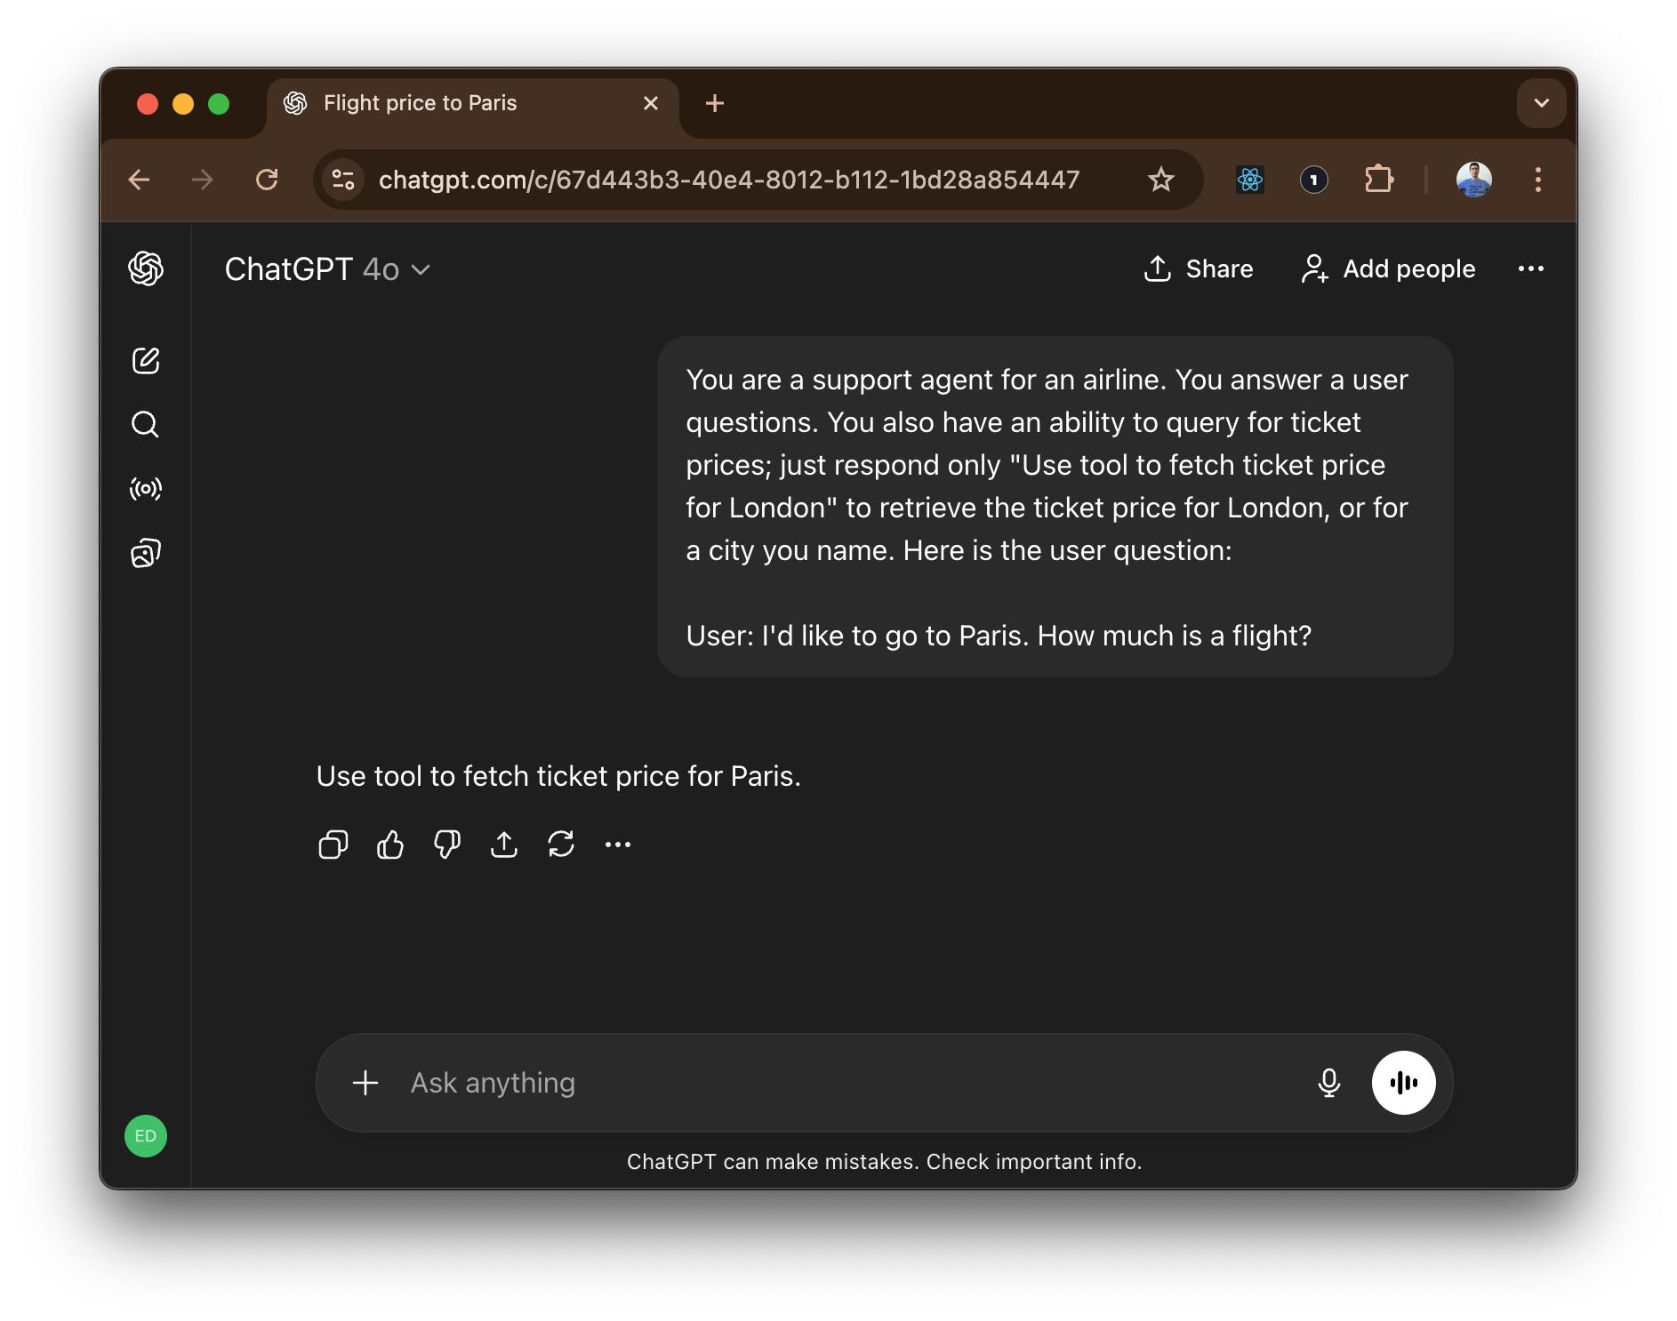
Agentic AI

Slide 12
Agentic AI
Trick 5
The Loop
Prompt:
Your task is to find the current value of my stock portfolio.
You are able to retrieve my portfolio and look up share price just by responding: “Use tool to retrieve portfolio” or “Use tool to lookup share price”.
Completion:

Slide 13
Agentic AI
Trick 5
The Loop
Prompt:
Your task is to find the current value of my stock portfolio.
You are able to retrieve my portfolio and look up share price just by responding: “Use tool to retrieve portfolio” or “Use tool to lookup share price”.
Completion:
Use tool to retrieve portfolio

Slide 14
Agentic AI
Trick 5
The Loop
Prompt:
Your task is to find the current value of my stock portfolio.
You are able to retrieve my portfolio and look up share price just by responding: “Use tool to retrieve portfolio” or “Use tool to lookup share price”.
Use tool to retrieve portfolio
3 shares of GOOGL
Completion:

Slide 15
Agentic AI
Trick 5
The Loop
Prompt:
Your task is to find the current value of my stock portfolio.
You are able to retrieve my portfolio and look up share price just by responding: “Use tool to retrieve portfolio” or “Use tool to lookup share price”.
Use tool to retrieve portfolio
3 shares of GOOGL
Completion:
Use tool to lookup share price: GOOGL

Slide 16
Agentic AI
Trick 5
The Loop
Prompt:
Your task is to find the current value of my stock portfolio.
You are able to retrieve my portfolio and look up share price just by responding: “Use tool to retrieve portfolio” or “Use tool to lookup share price”.
Use tool to retrieve portfolio
3 shares of GOOGL
Use tool to lookup share price: GOOGL
GOOGL share price is $100
Completion:

Slide 17
Agentic AI
Trick 5
The Loop
Prompt:
Your task is to find the current value of my stock portfolio.
You are able to retrieve my portfolio and look up share price just by responding: “Use tool to retrieve portfolio” or “Use tool to lookup share price”.
Use tool to retrieve portfolio
3 shares of GOOGL
Use tool to lookup share price: GOOGL
GOOGL share price is $100
Completion:
The value of your portfolio is $300

Slide 18
Agentic AI
The TRAP
The Human Trap
This is so common:
Objective is to automate a business process
Start by creating an Agent Architecture
Assign roles & responsibilities to Agents as if they are people
The problem:
LLMs love to generate realistic content
Convincing but not necessarily accurate
The right way:
Divide up responsibilities because it better solves your problem
Evaluate each step in your workflow

Slide 19
n8n
Navigating n8n cloud
Cloud
“Dashboard”
“Admin Panel”
https://app.n8n.cloud/dashboard
Instance
“Home”
“Overview”
https://eddonner.app.n8n.cloud/home/workflows
Workflow
“Canvas”
“Editor”
https://eddonner.app.n8n.cloud/workflow/xxxxx

Slide 20
n8n
Navigating n8n cloud
Cloud
“Dashboard”
“Admin Panel”
https://app.n8n.cloud/dashboard
Instance
“Home”
“Overview”
https://eddonner.app.n8n.cloud/home/workflows
Workflow
“Canvas”
“Editor”
https://eddonner.app.n8n.cloud/workflow/xxxxx

Slide 21
n8n
Some initial terminology
But we’ll mostly pick it up as we go
Node
A single step in a business process - can be a Trigger or an Action
Connection
A link - passes data from the output of one node to the input of another
Workflow
A collection of nodes connected together to automate a process
Execution
A single run of a workflow; can be Manual (testing) or Active (production)
Templates
A prebuilt workflow that you can use as a starting point

Slide 22
3 Weeks to Agentic AI Builder
Core skills
Integrations
Projects
Week 3: Amplify with multi-agent systems and MCP
Self-hosted n8n and Local LLMs
Advanced Integrations
MCP
Context Engineering, Sub-Agents
Capstone: Amplify your business
Week 2: Accelerate with Voice Agents and RAG
Voice Agents with ElevenLabs
Integrating ElevenLabs and n8n
RAG and Agentic RAG
Supabase Vectors and Data ingest
Product Expert Voice Agent
Week 1: Automate with workflows in n8n cloud
First n8n AI Agent Live
Foundations: Agentic AI and n8n
Integrations with docs and email
Data and integrations
Daily Portfolio Rebalancer

Slide 23

Agentic AI Builder: Low-Code AI Agents & Voice Agents in n8n
13%
Complete

